Slide 1
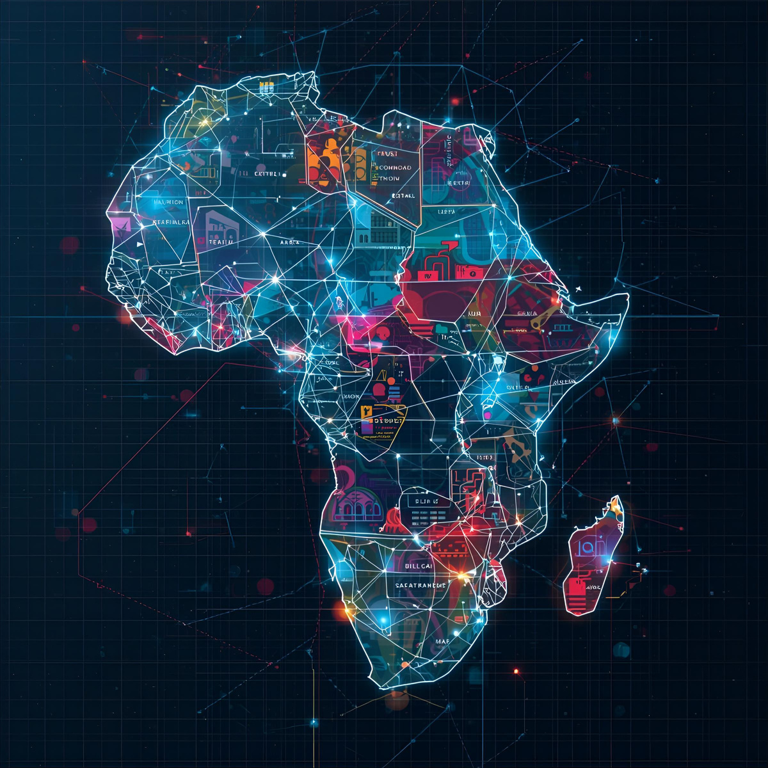
BlkSageStudios
Mapping The Next Billion: The Ai Readiness Index
Page 1
Notes:
BlkSageStudios presents to you Mapping the Next billion; The Ai Readiness Index
This presentation is sponsored by: 5 do overs, forced procrastination, and Code that Finally Runs.

Slide 2
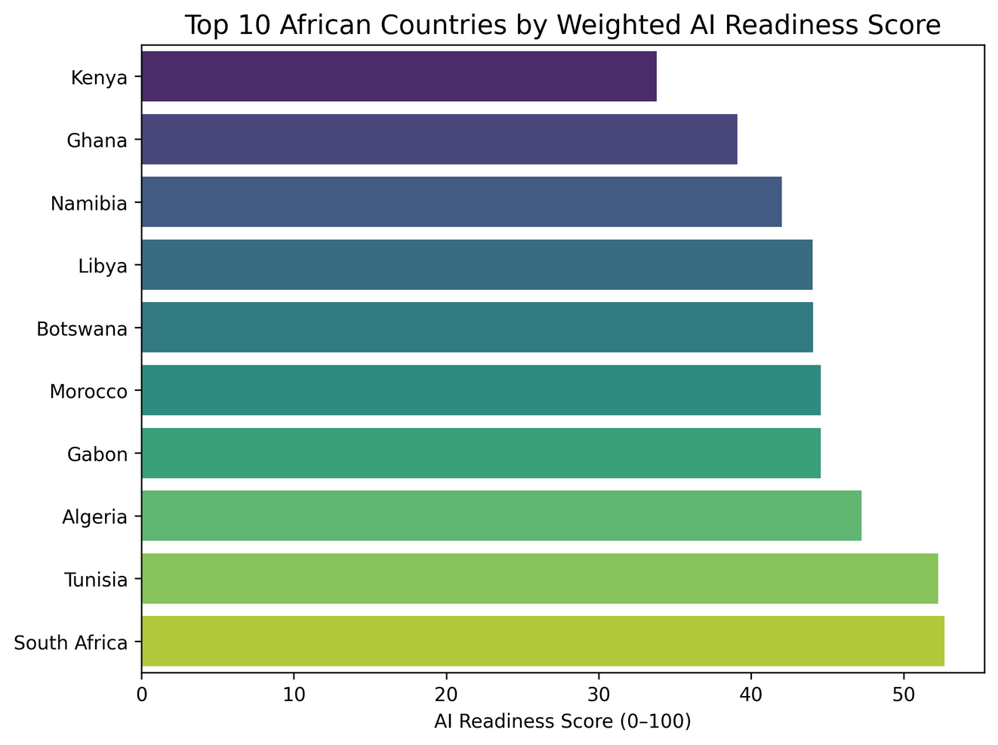

BlkSageStudios
The Answer
You cannt make this up.
Page 2
Notes:
The Answer
Here are the top ten countries in Africa ranked by their readiness score.
We thought this would be the hard part... getting to a number.
Putting a period on a measure of work
Turns out that the end was a new beginning for us.
The problem we sought to answer was is the African market ready for Ai.
and in the beginning we thought it might just be about access — electricity, internet, maybe GDP.
But the deeper we looked, the clearer it became: that wasn’t enough.
Readiness isn’t a single measure, it’s a system.
You need infrastructure like electricity and broadband.
You need human capacity — literacy, tertiary education, researchers.
You need governance — effectiveness in how systems are run.
And you need resources — GDP and R&D investment.
So we built a composite score across nine indicators, each one a different piece of the puzzle.
That became the foundation for the next steps.

Slide 3
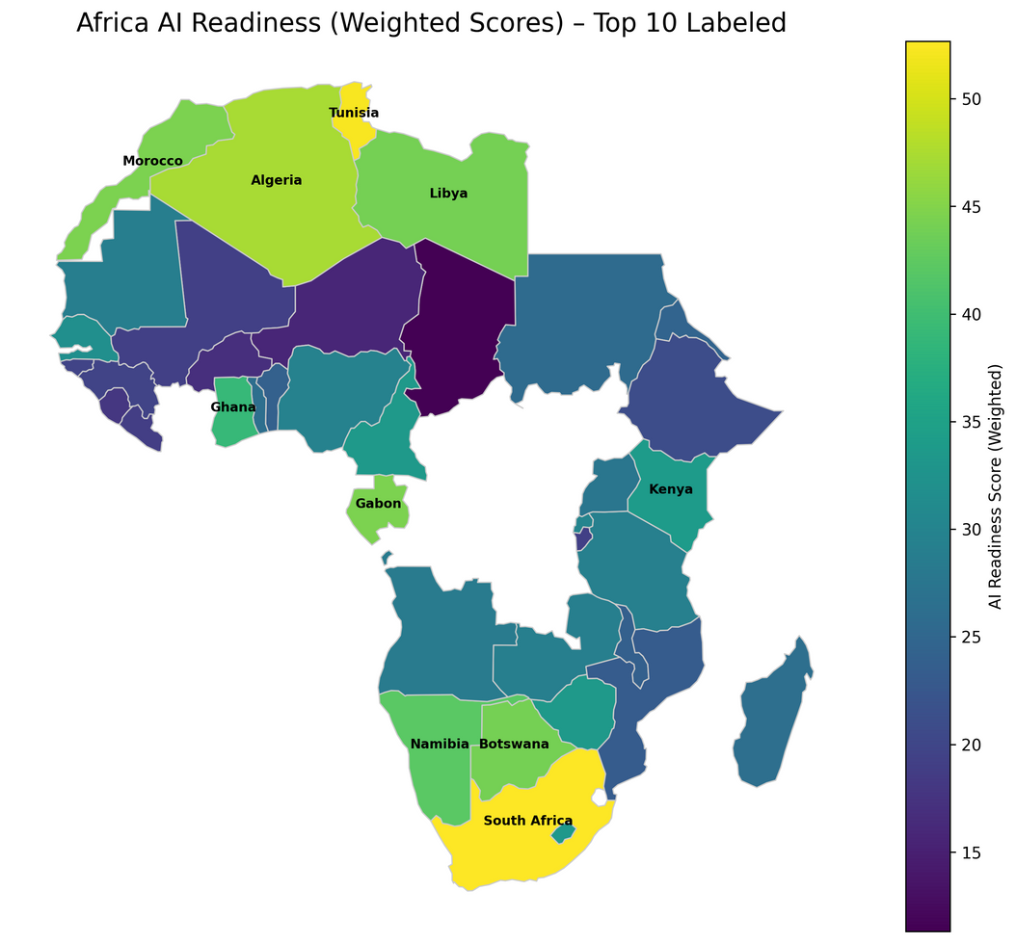
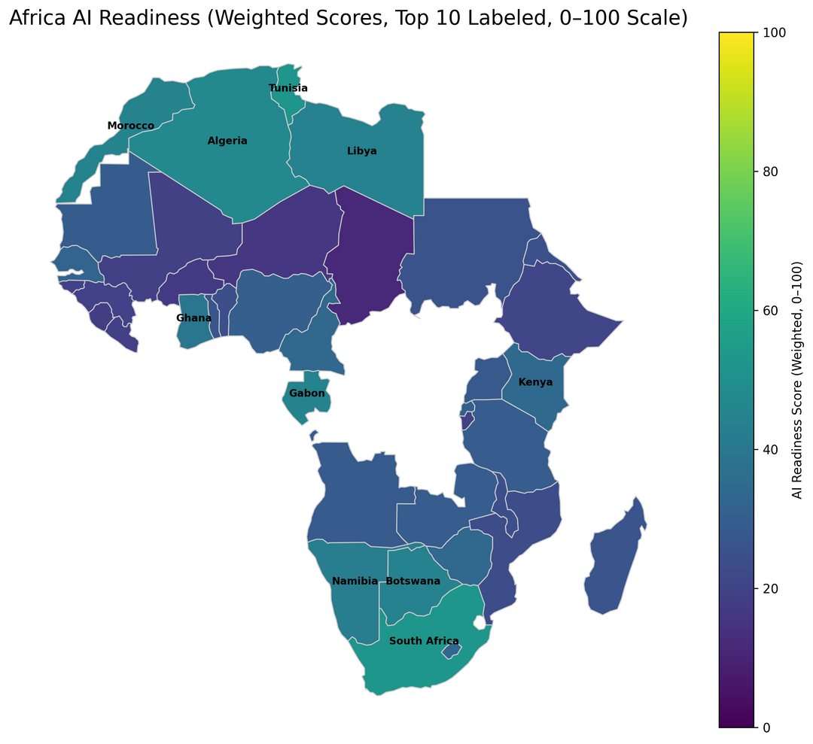
BlkSageStudios
Perception
VS
Page 3
Notes:
They say that numbers don't lie... people do, but what are random numbers adrift in the ether devoid of context?
We just gave you a list and told you they were the top ten countries in Africa that are ready for Ai implementation. but how did we get there and what exactly did you see?
What we presented was a snapshot.
A still moment in time where the numbers weren't moving with the change of policy, commerce, innovation, population growth, Gdp, or literacy rate.
It was one point in time and a culmination of these things but only at that time and only in that place.
At the same time the image on the left was produced, indicative of what you saw, the image on the right exists
in that same space and time but from a slightly different perspective.
Perception

Slide 4
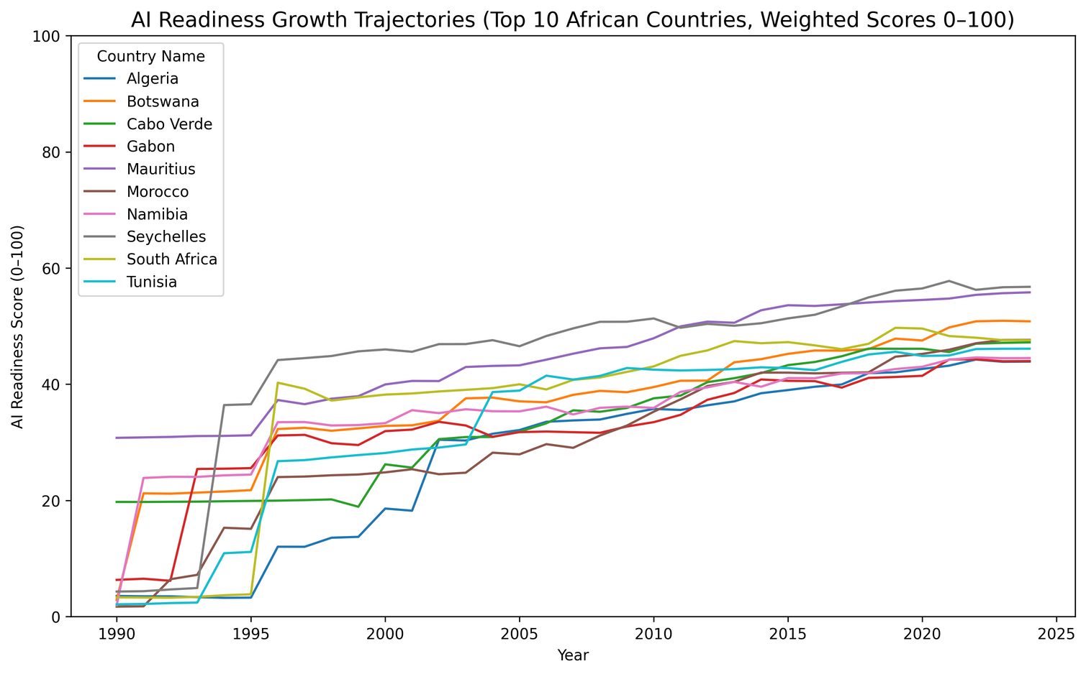
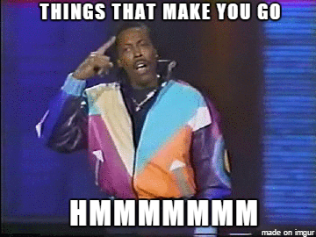
BlkSageStudios
Time
Page 4
Notes:
So why would you want to invest in the growth and independence of Africa's Ai?
Here's that same list but not as a snapshot — as a trajectory.
What you see is steady upward movement over time.
Some countries climb faster than others, but the overall trend is growth, not decline.
This is important, because it means readiness isn’t just about where you are today.
It’s about the path you’re on, and whether that path is sustainable.
For Africa, the story isn’t flat. It’s progress in motion.
It also brings into play politics and all of the seeming intangibles.
A good example is South Africa. It is a powerhouse of a country in the continent as far as GDP but they are middle of the pack.
Is this because of stifled RnD , politics, or their divestment from continental unity.
All things that make you go Hmmm.

Slide 5

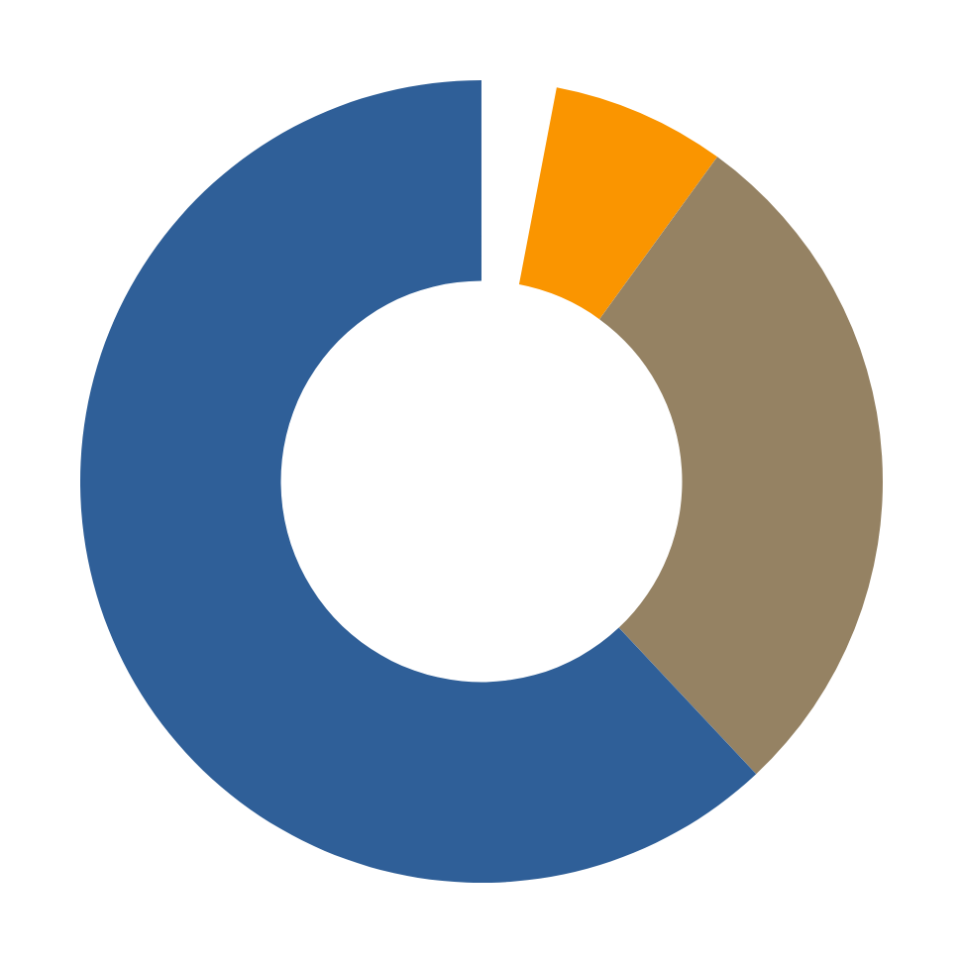



BlkSageStudios
Market
65+ years: Over 52 million
50–64 years: Over 117 million
> 30 years: Over 980 million
30–49 years: Over 437 million
Research
Page 5
Notes:
Maybe a better question is why wouldn't you want to invest in The Great Continent's future?
Roughly 70% of Africa's population is under 30 years of age according to the UN.
70% of 1.6 billion people. The only other continent in this conversation is Asia, and that's a split between India and China.
Add that to a mobile first environment.
What i mean is you're looking at a supremely innovative and agile demographic.
Proof of this is back in 2007 pay pal required bank accounts credit cards and email addresses, meanwhile Kenya launched a fintech system that worked on flip phones.
The company was M-Pesa, and they currently process more transactions than paypal did in it's first decade.
While western tech was optimizing features, they were optimizing inclusion.
Inclusion is the model.

Slide 6
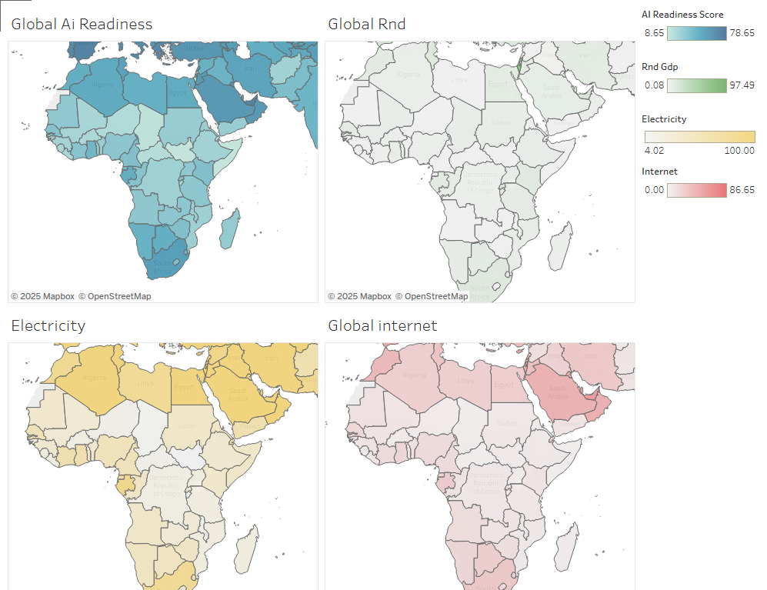
Time
BlkSageStudios
Page 6
Tableau Link
Heahttps://public.tableau.com/authoring/GlobalAiReadiness/Dashboard1#1ding
Notes:
So where does africa and their top ten fit into the bigger picture?
After scoring, we mapped it.
This shot of our Tableau dashboard offers a glimpse into some of the data types collected and their correlation to ai readiness. Specifically South Africa, Egypt, Nigeria
And what you see is clear: African countries are not at zero.
That matters, because the common narrative is often that Africa is “behind.”
But the data shows something different.
Africa isn’t at the starting line — it’s already in the race.

Slide 7
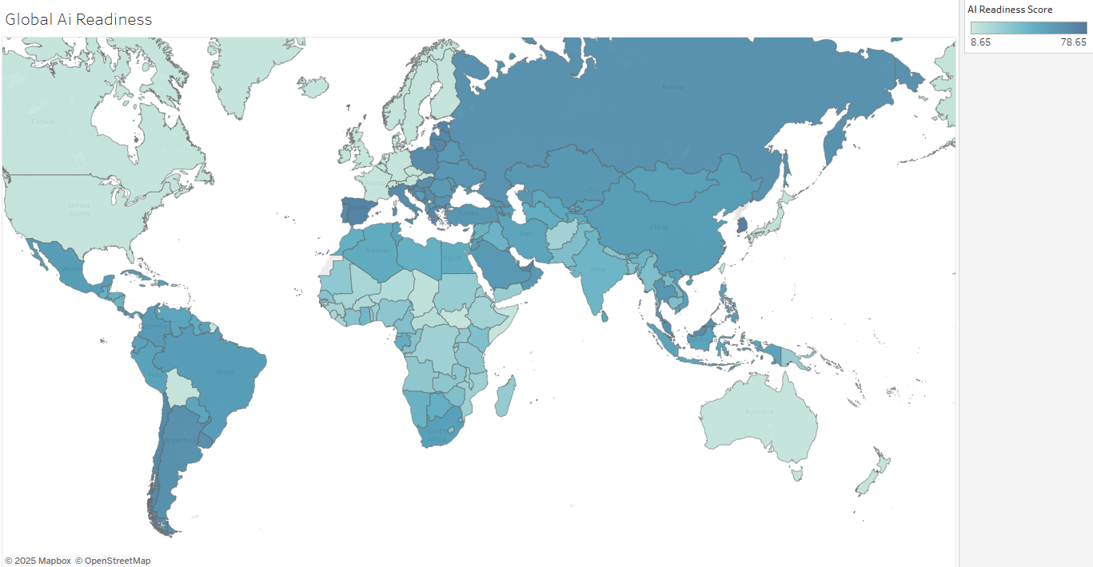
Time
BlkSageStudios
Page 7
Tableau Link
Heahttps://public.tableau.com/authoring/GlobalAiReadiness/Dashboard1#1ding
Notes:
In fact the top countries in Africa are right at the mid line.
This is despite having some of the highest internet costs in the world, and broadband reliability akin to a road network under construction — the highways are being laid through undersea cables and urban fiber, but many rural communities are still waiting for the on-ramps.”
While this isn't interactive here, we want to take note of the readiness score range 78.65 being the highest and the lowest being 8.65. The top ten countries in Africa sit right above average for that range.
To get here we started with only five data points thinking across 54 countries this would be enough data to provide an adequate picture.
But as we began to dig we realized that it wasn't even remotely close, for various reasons.

Slide 8
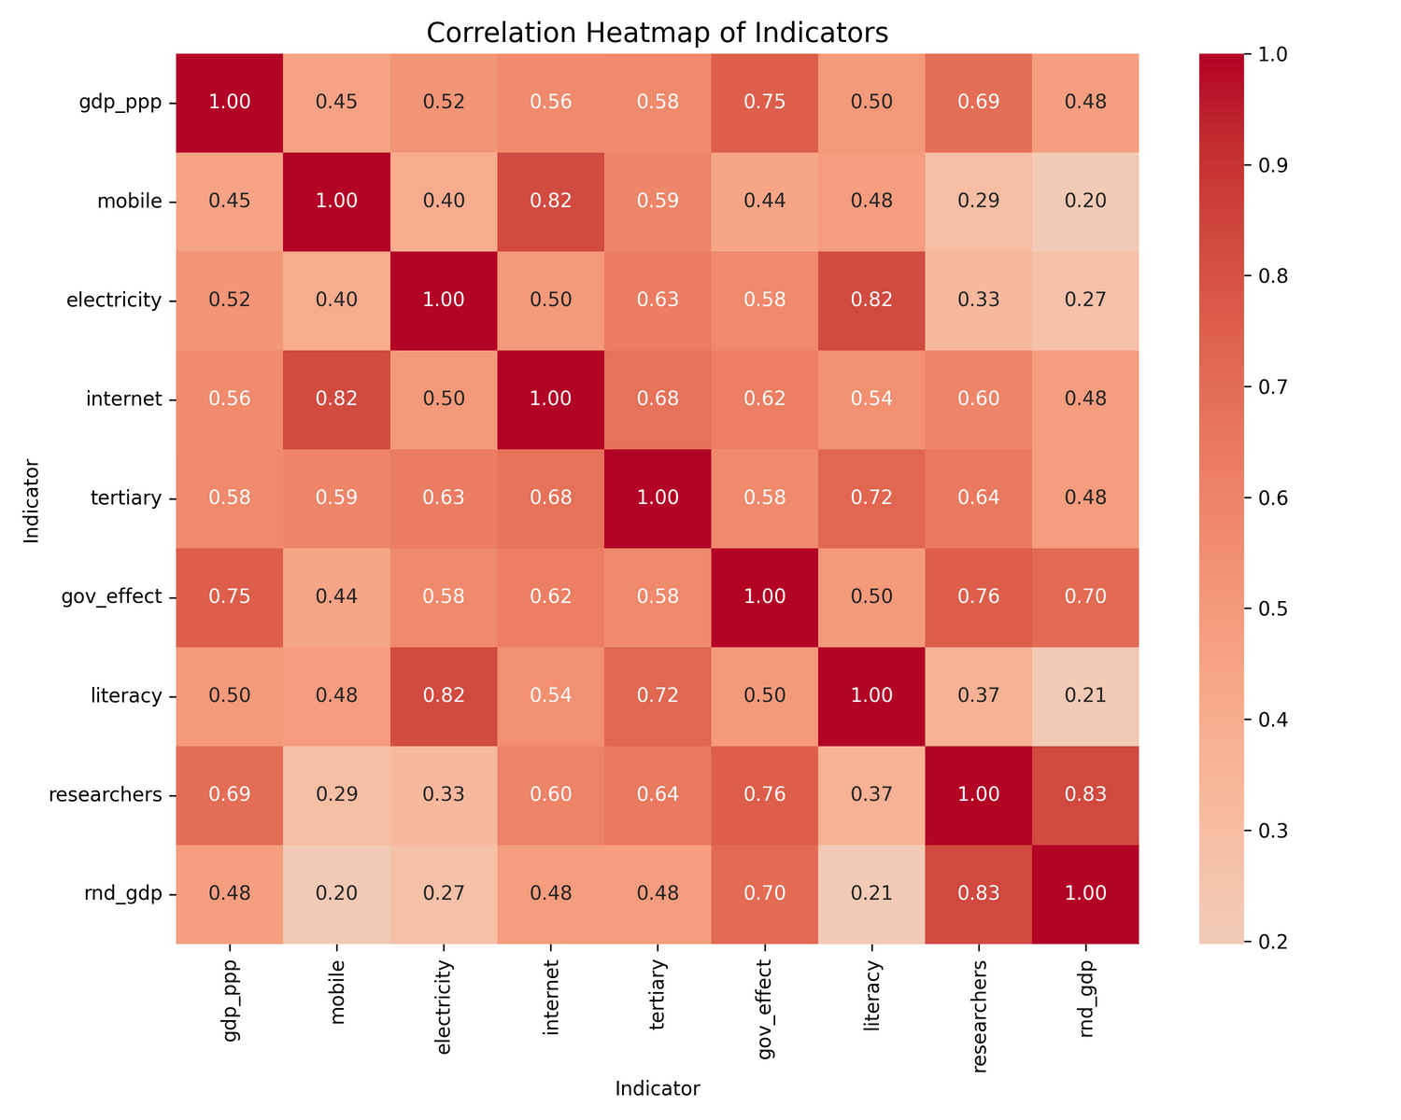

BlkSageStudios
The Data
Page 8
Notes:
So we expanded our feature list, i mean surely we weren't the first to think of this idea.
We took took a broader view of how all of this data worked together at a glance. And the bones began to speak.
We ran this correlation heatmap.
And it exposed, for example, how internet and mobile subscriptions are strongly correlated. Or how GDP and governance also track closely together.
But you also see gaps, like researchers (per million) and mobile or even worse how literacy and rnd_ gdp barely connect.
The takeaway here is that no single indicator could stand on its own.
That’s why we had to bring them all together into a system.
Scaling everything 0–100 so GDP, literacy rates, electricity access, and researchers per million could all be compared on the same footing.

Slide 9
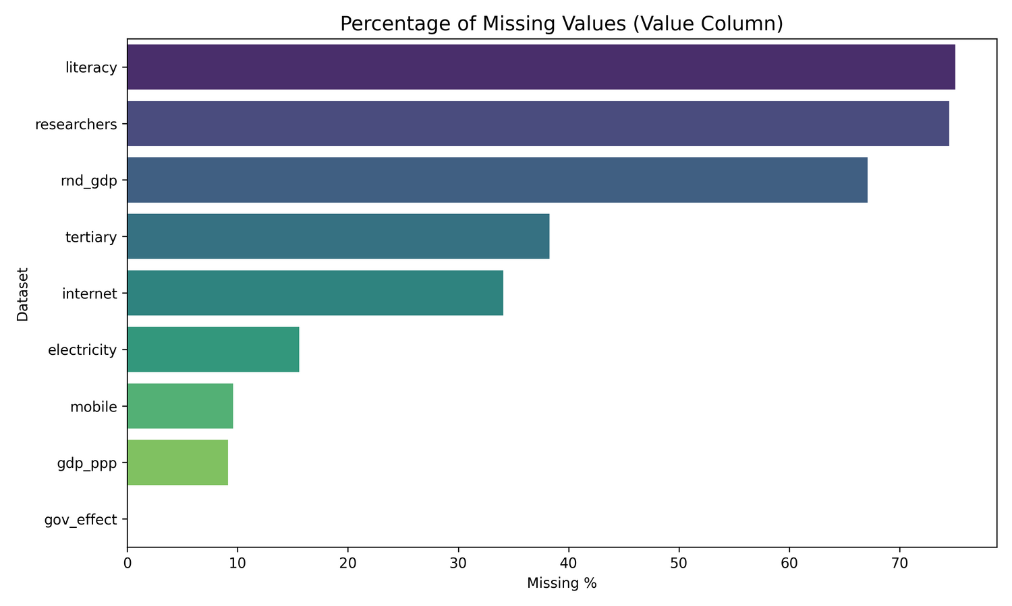
BlkSageStudios
Data Gaps
Page 9
Notes:
But before we got to the correlation matrix we had the grand canyon of missing data.
One would think that since all of our data came from world bank that it would be good data.
The truth is this is the primary reason we had to pull in other data points to fill out the information and keep it balanced enough to run clustering and such.
Even with the expanded features you can see how much data is missing according to this graph:
As science would have it, countries that fared better in these areas of data collection often fared better in their readiness score.

Slide 10
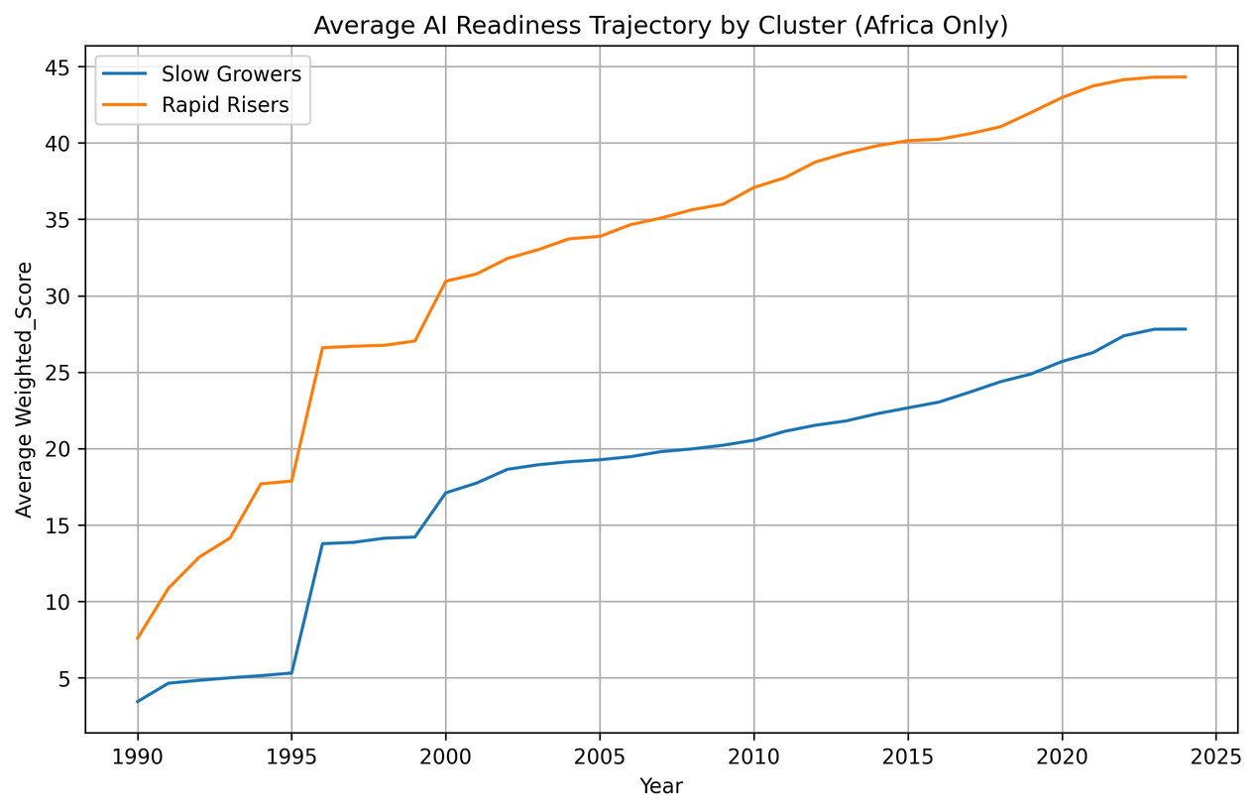
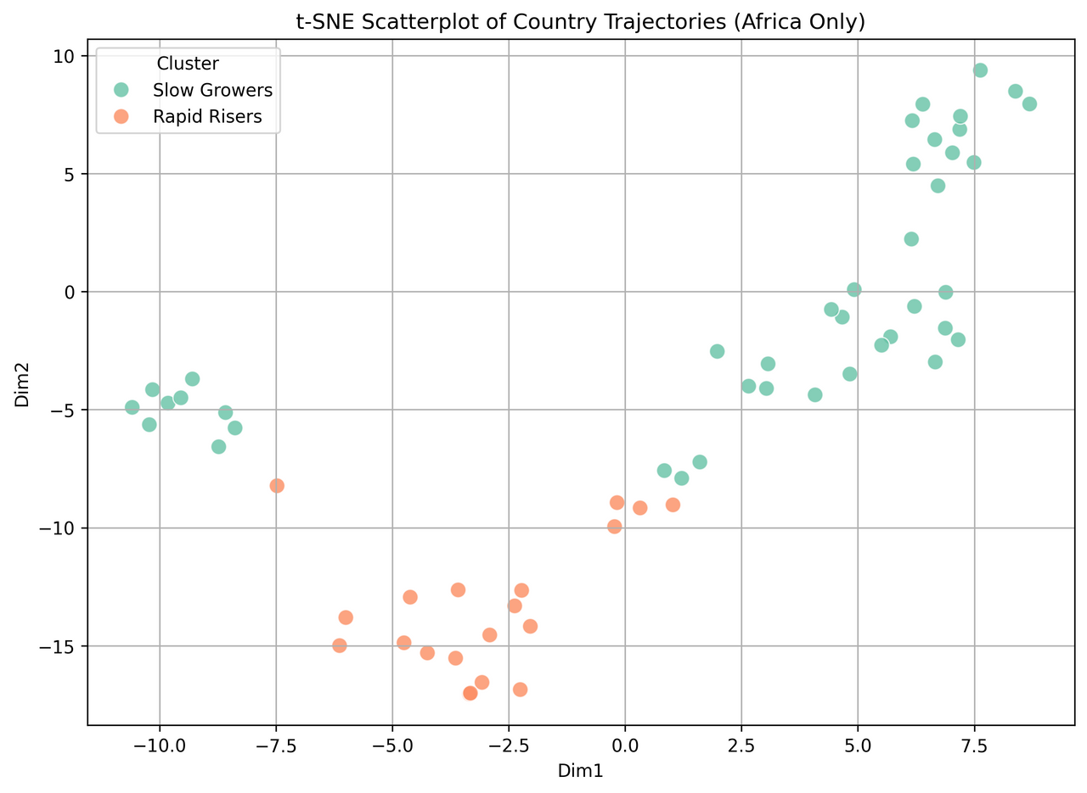
BlkSageStudios
Early Birds
Page 10
Notes:
We looked for the patterns using clustering on the trajectories for African countries.
What we found is that Africa splits into two groups.
The first group we call the Rapid Risers — countries with stronger electricity, higher internet use, better literacy, and steeper growth curves.
The second group is the Slow Growers — countries where electricity access is lower, internet penetration is weaker, and progress is flatter.
In 2024, the Rapid Risers include countries like Seychelles, Mauritius, Botswana, Morocco, and South Africa.
The Slow Growers include Rwanda, Kenya, Senegal, Cameroon, and Zambia.
What’s striking is the imbalance — 41 African countries are in the Slow Grower group, while only 20 are Rapid Risers.
It shows momentum through the struggle.

Slide 11
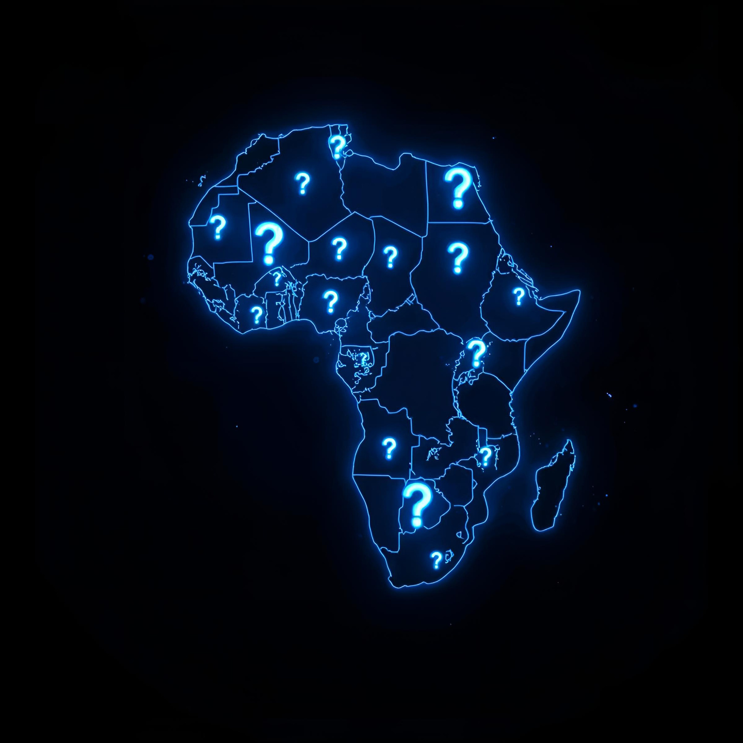
BlkSageStudios
Top 5 LLm’s
You cannt make this up.
GPT-5
DeepSeek-R1
Gemini-2.5
Claude 4
Llama 4
Page 11
Notes:
And the struggle is real, but Inclusion IS the model.
AI is expanding rapidly — but almost entirely on Western-owned, cloud-based platforms. This raises two critical issues for non western affiliated countries in particular those in Africa:
Security & Sovereignty
Cloud-first AI systems place African data in foreign hands, creating risks of surveillance, exploitation, and dependency.
Without localized infrastructure, Africa’s role becomes one of passive data provider rather than active innovator.
There are also Cultural Assumptions
Today’s large language models are trained mostly on Western data, embedding foreign norms, priorities, and blind spots.
They often misinterpret African languages, contexts, and values, leading to irrelevant or even harmful outputs.
Without a native AI ecosystem, Africa risks importing tools that do not reflect its realities heritage or culture.

Slide 12
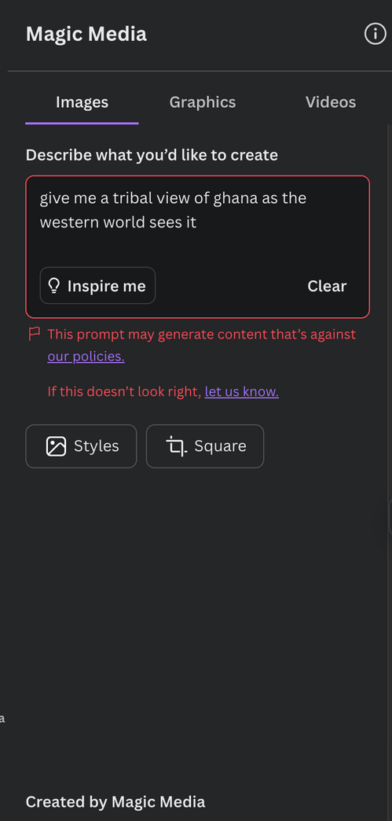

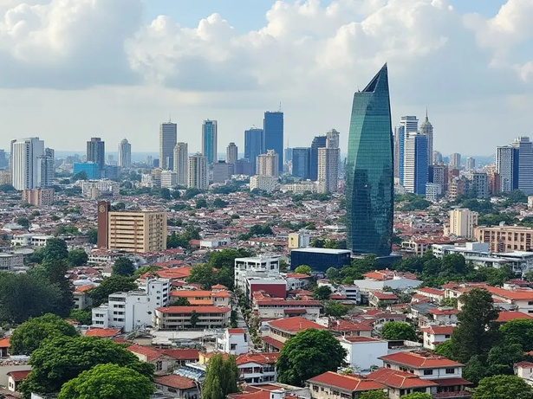
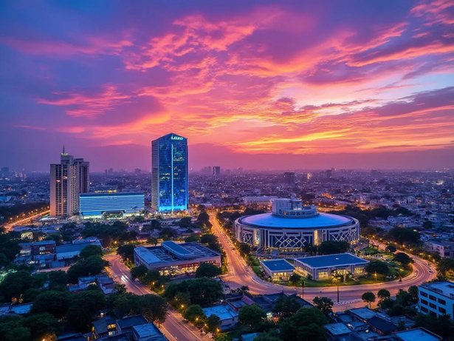

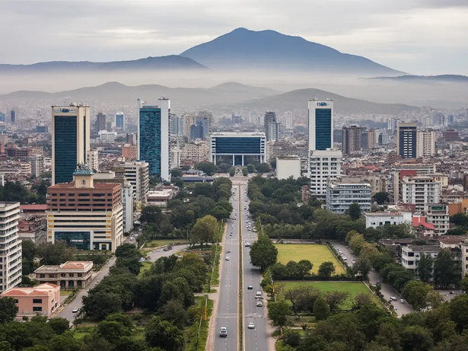
Narrative
BlkSageStudios
Accra
Abuja
You cannt make this up.
Algiers
Addis Ababa
Page 12
Notes:
John Hope Bryant, billionaire philanthropist, recently stated that the implementation of AI is the greatest equalizer in history.
I concur, so what picture is painted when such a tool is clearly biased?
There is a book that has a line that says, “How forceable are right or just words?”
They say a picture's worth a thousand words.
Is this how the story gets distorted before it's even told?
The divide is not just about access to electricity or broadband — it’s about who controls the narratives, the data, and the intelligence.
It's about ensuring Africa has their own pen with which to write their future.
As the proverb says: “Until the lions have their own historians, the history of the hunt will always glorify the hunter.”
Accra Ghana
Abuja Nigeria
Algiers Algeria
Addis Ababa Ethiopia

Slide 13

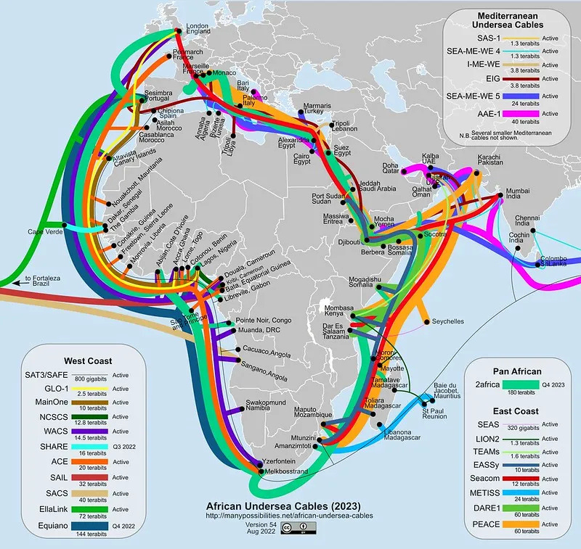
BlkSageStudios
Foreign
Interest
Page 13
Notes:
Here’s a twist in the story.
It’s not just US looking at AI readiness.
France, through the AFD, has already launched its own AI Investment Potential Index — a project very similar in scope to this one.
At the same time, Google is moving in on the infrastructure side.
Their Equiano subsea cable now connects Europe to multiple points along Africa’s west coast.
And they’ve been public about one thing: fiber cables should be treated as critical infrastructure across the continent.
The takeaway is clear — global powers are already building their stakes in Africa’s AI future.
Which means the question isn’t if this matters.

Slide 14
BlkSageStudios
The End
Page 14
Notes:
We’ve seen the story through the data.
We’ve seen the cracks in the systems, and the strengths that are already building.
We’ve seen that readiness isn’t just a number. It’s sovereignty.
And we’ve seen that the world is already watching — and moving in.
So I’ll leave you with this:
The question isn’t if Africa is ready for AI.
The question is whether Africa gets to own the narrative, or whether it’s written for them.
For The Greater Good.

